Slide 1



Paper ID 01
Realistic and Lightweight Driver Drowsiness Detection Using MobileNetV2 Features and Logistic Regression with Noise-Robust Learning
Paper Id : 890
Moghal Babar
Computer Science and Engineering
Narasaraopeta Engineering College,Narasaraopet,Andhra Pradesh,India
2025 IEEE International Conference on Recent Advances in Computing and Systems, 19 -20 Dec 2025 | ABV-IIITM Gwalior India

Slide 2
Presentation Outline
Title
Introduction / Background
Problem Statement
Dataset Description
Objectives
Methodology / System Architecture
Performance Measures
Results and Analysis
Conclusion and Future Scope
References
890

Slide 3
Introduction / Background
Driver drowsiness is a major cause of road accidents worldwide.
Fatigue affects attention, perception, and reaction time.
Traditional methods using physiological sensors are intrusive and impractical.
Vision-based approaches are non-invasive and suitable for real-time use.
Lightweight deep learning models enable deployment on embedded systems.
890

Slide 4
Problem Statement
Existing drowsiness detection systems are computationally heavy.
Many methods fail under real-world conditions like low light and motion blur.
There is a need for a fast, accurate, and lightweight solution.
The system must work reliably on resource-constrained devices.
890

Slide 5
Dataset Description
Eye image dataset containing 4,103 samples.
Two classes: Opened (2,171) and Closed (1,932) eyes.
Images show variations in lighting, head pose, and eye shape.
Dataset is nearly balanced to avoid class imbalance issues.
Gaussian noise is added during training to improve robustness.
890

Slide 6
Objectives
Detect driver drowsiness using eye-state analysis.
Extract deep features using MobileNetV2.
Use a simple and efficient classifier for decision-making.
Improve robustness against noise and visual distortions.
Achieve real-time performance with minimal computational cost.
890

Slide 7
Methodology / System Architecture
The system workflow includes:
1.Dataset Acquisition
2.Preprocessing
3.Feature Extraction using MobileNetV2
4.Noise-Aware Training
5.Logistic Regression Classification
890

Slide 8
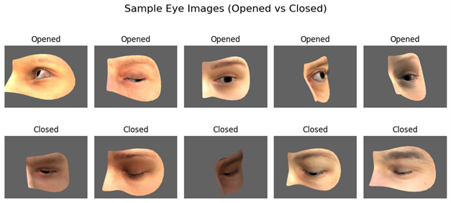
Preprocessing Pipeline
Standardized resizing of images to 128×128
Normalization performed for model compatibility
Manual inspection ensures correctness of labels and visual clarity
890

Slide 9
Feature Extraction with MobileNetV2
MobileNetV2 used as deep feature extractor
Pre-trained on ImageNet
Classification head removed
Extracts rich representations like:
  eyelid contours
  iris edges
  illumination patterns
890

Slide 10
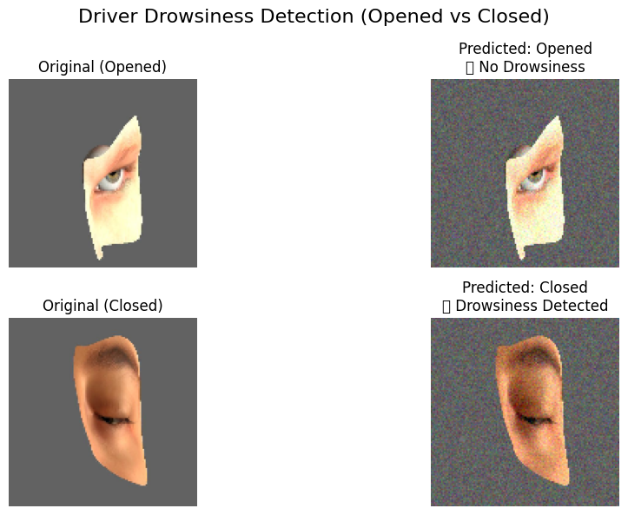
Classification Using Logistic Regression
Simple binary classifier chosen for:
  low computation cost
  clarity
  real-time feasibility
Separates two classes:
  Open Eye
  Closed Eye
890

Slide 11
Training & Validation Setup
80% dataset used for training
20% dataset used for testing
Training executed using cloud GPU environment
Gaussian noise applied throughout training to improve generalization
890

Slide 12
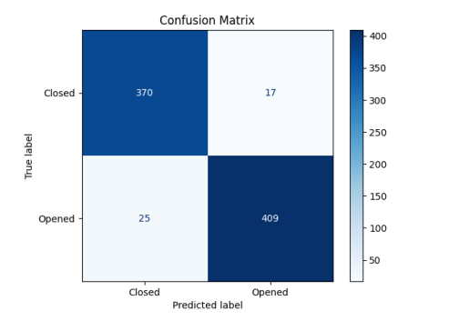
Performance Measures
Accuracy
Precision
Recall
F1-score
Confusion Matrix
Inference time per image
Model size and memory usage
890

Slide 13
Results and Analysis
Test accuracy achieved: 95.0%.
Precision: 0.94, Recall: 0.95, F1-score: 0.945.
Inference time: 0.008 seconds per image.
Model size: 14 MB, suitable for embedded systems.
High recall for closed-eye class ensures reliable drowsiness detection.
Noise-augmented training improves performance under degraded conditions.
890

Slide 14
Conclusion and Future Scope
Conclusion
A lightweight and efficient drowsiness detection system was developed.
MobileNetV2 + Logistic Regression provides a good balance of accuracy and speed.
System performs well under noisy and real-world conditions.
Suitable for real-time deployment in vehicles and mobile devices.
Future Scope
Integration with in-vehicle driver monitoring systems.
Incorporating additional cues like head pose and blink duration.
Deployment on real embedded automotive hardware.
Extension to full video-based continuous monitoring.
890

Slide 15
References
Xu et al., Driver Fatigue Detection Using Eye States, IEEE Access, 2022.
Kumar et al., Driver Drunk Detection by Sensors, Sensors Journal, 2021.
Park et al., EEG and Eye Blink Fusion for Fatigue Detection, BSPC, 2020.
Gupta et al., Transfer Learning for Drowsiness Detection, PRL, 2023.
Li et al., Review on Eye Activity-Based Drowsiness Detection, IEEE T-ITS, 2022.
Zhang et al., Multi-Channel SOBI for Drowsiness Detection, Neurocomputing, 2021.
THANK YOU
890

